Slide 1
Governance
The forgotten key to managing Cloud

Slide 2
Governance
The forgotten cloud killer

Slide 3
We’re doing this in the cloud because our IT don’t have time to be involved

Slide 4
We’ll build the prototype and then worry about governance

Slide 5
Cloud is new to us, so we’re looking for this development team to work it out as they go

Slide 6
Unexpected high billing
Data outside accepted jurisdiction
No audit trail
No way to associate cost with department
Component services unavailable in acceptable regions
Unsecured personal data

Slide 7
Areas of Governance

Slide 8
Technology Governance
What Azure services are acceptable for use in projects… …because of where they store your data …because of how they deal with your data …because of how skilled you are in using them …because of what your existing choice is in that area

Slide 9
Location Governance
What Azure regions are acceptable for use… …because of where you need to store your data …because of how much they cost …because of where your customers are …because of where your customers need to store their data

Slide 10
Security Governance
How access to cloud services is controlled… …because you need to limit access to data …because you need to audit activity …because your customer mandates specific processes …because people join and leave your organisation

Slide 11
Purchasing Governance
How you report on and recharge Cloud costs, and purchase the services… …because you want to be cost-effective …because you need to internally recharge …because you need to bill your customers

Slide 12
Implementation
List of acceptable services and regions
Resource naming convention
Grouping resources by Resource Group
Grouping resources by Subscription
Resource tags
Identity management
RBAC
Reporting

Slide 13
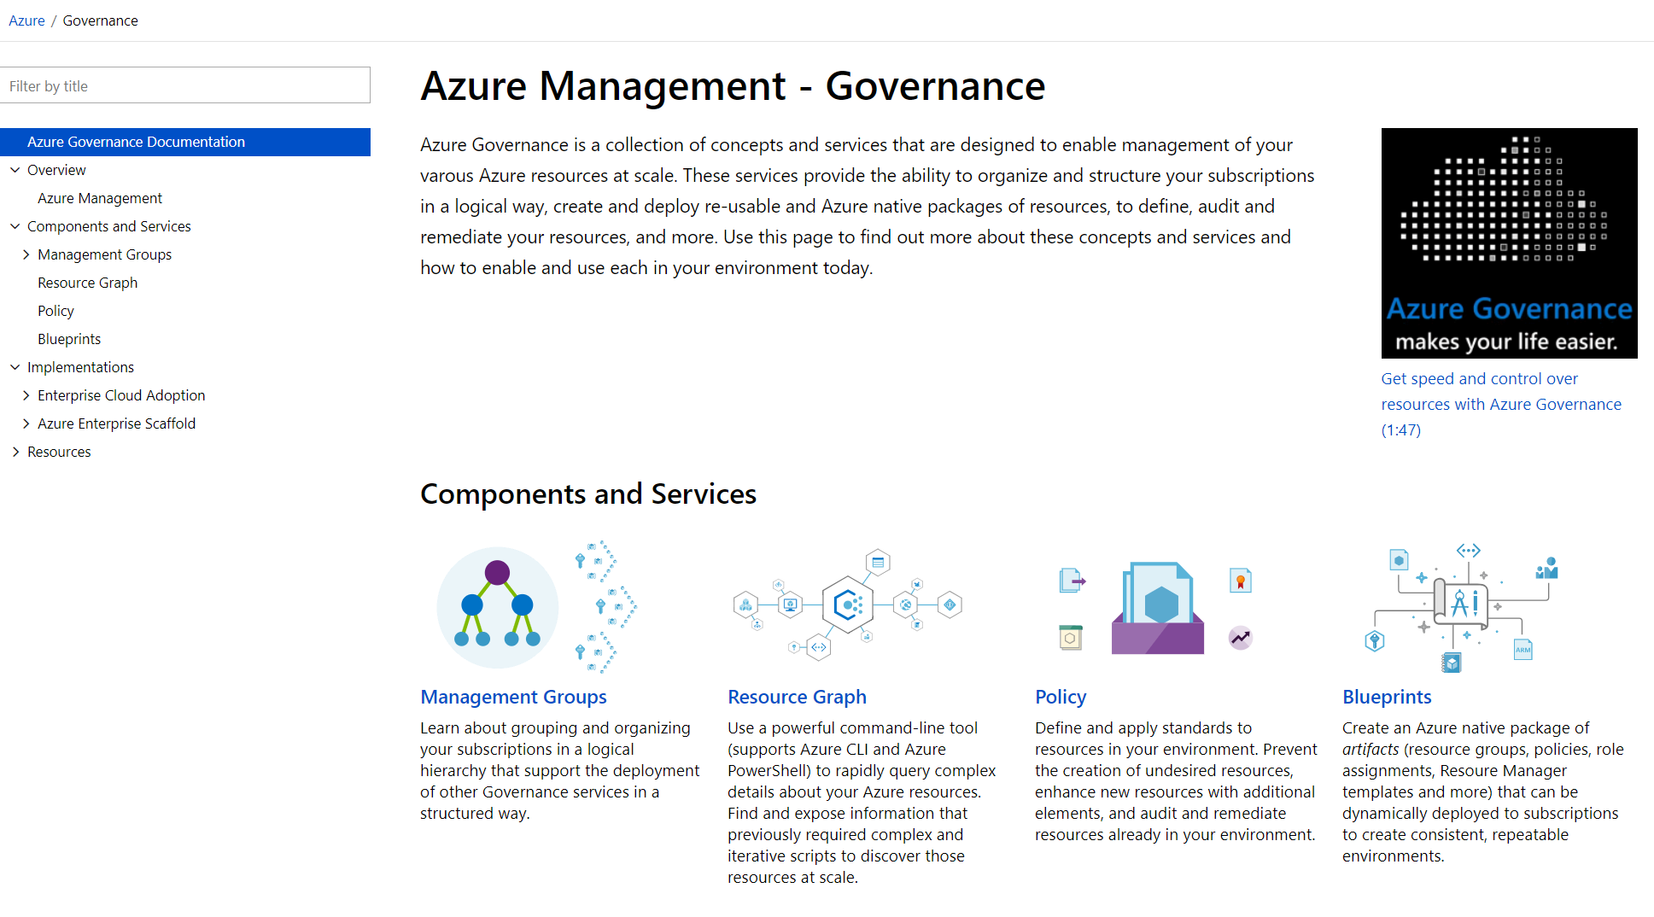
aka.ms/GovernanceDocs -or- docs.microsoft.com/azure/governance

